Slide 1

French fama 3-factors model based allocation
Robert Leiser
Arun Thiravianathan
Nhat Pham

Slide 2
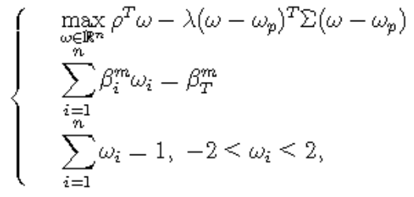
Strategy
Portfolio optimization in the form:
Using various lookback period lengths and target Betas for optimization
Benchmarked using S&P 500 (SPY)

Slide 3
Data
1. CurrencyShares Euro Trust (FXE) 2. iShares MSCI Japan Index (EWJ) 3. SPDR GOLD Trust (GLD) 4. Powershares NASDAQ-100 Trust (QQQ) 5. SPDR S&P 500 (SPY) 6. iShares Lehman Short Treasury Bond (SHV) 7. PowerShares DB Agriculture Fund (DBA) 8. United States Oil Fund LP (USO) 9. SPDR S&P Biotech (XBI) 10. iShares S&P Latin America 40 Index (ILF) 11. iShares MSCI Pacific ex-Japan Index Fund (EPP) 12. SPDR DJ Euro Stoxx 50 (FEZ)
Source: Yahoo Finance

Slide 4

French fama factor model
$r_{i}=r_{f}+β_{i}^{3}\left(r_{M}−r_{f}\right)+b_{i}^{s}r_{SMB}+b_{i}^{v}r_{HML}+α_{i}+ε_{i}$
Data source: http://mba.tuck.dartmouth.edu/pages/faculty/ken.french

Slide 5
Time frame
Pre-crisis: July 02, 2007 – Nov 20, 2007
During crisis: Nov 21, 2007 – Mar 32, 2009
Post-crisis: April 01, 2009 – Oct 29, 2021

Slide 6
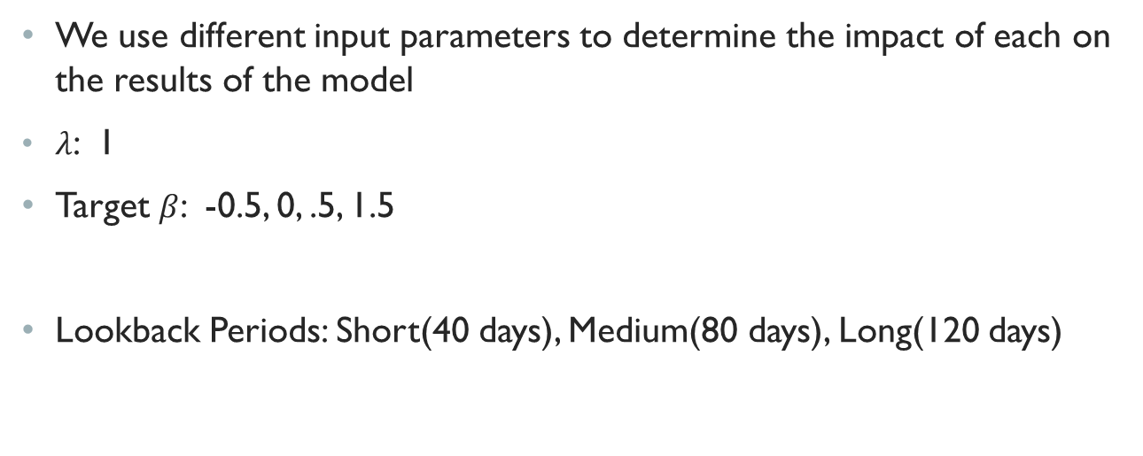
Parameters
We use different input parameters to determine the impact of each on the results of the model
$λ$: 1
Target $β$: -0.5, 0, .5, 1.5
Lookback Periods: Short(40 days), Medium(80 days), Long(120 days)

Slide 7
Pre-crisis
 | S&P | Beta: -0.5 | Beta: 0 | Beta: 0.5 | Beta: 1.5
P&L | -4.258438 | 64.948271 | 78.227922 | 91.374839 | 113.945556
sharpe ratio | -0.503593 | 1.871370 | 2.052438 | 2.205537 | 2.387610
VaR | -0.019293 | -0.085529 | -0.088020 | -0.090404 | -0.097306
Minimum | -0.029633 | -0.261133 | -0.278858 | -0.287204 | -0.311547
Maximum | 0.030480 | 0.135177 | 0.132375 | 0.127254 | 0.143579
Variance | 0.000131 | 0.003106 | 0.003340 | 0.003568 | 0.004198
Stdev | 0.011450 | 0.055735 | 0.057789 | 0.059735 | 0.064789
Skewness | -0.270922 | -1.256556 | -1.368166 | -1.346572 | -1.284062
Kurtosis | 0.424338 | 4.921330 | 5.460707 | 5.324269 | 5.221598
90 days of return
60 days of covariance

Slide 8
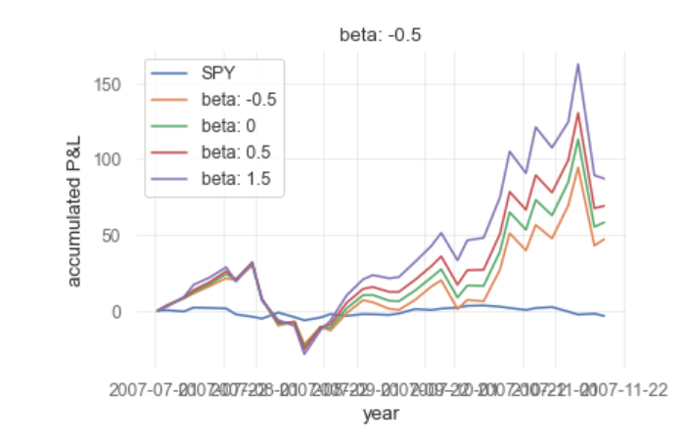
Beta effect beforecrisis

Slide 9
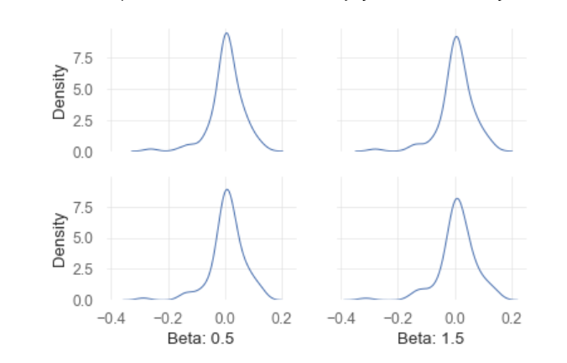
Beta effect Before crisis

Slide 10
Pre-crisis
 | S&P | 40 days | 80 days | 120 days
Accumulated Return (%) | -0.036870 | 0.936268 | 0.857035 | 0.758393
sharpe ratio | -0.503589 | 2.120667 | 2.106221 | 2.052413
VaR | -0.019293 | -0.104869 | -0.096711 | -0.088020
Minimum | -0.029634 | -0.277799 | -2.067928e-01 | -0.278861
Maximum | 0.030480 | 0.170826 | 1.588945e-01 | 0.132376
Variance | 0.000131 | 0.004768 | 4.049729e-03 | 0.003340
Stdev | 0.011450 | 0.069047 | 6.363748e-02 | 0.057789
Skewness | -0.270917 | -0.801237 | -6.397761e-01 | -1.368190
Kurtosis | 0.424358 | 2.251134 | 1.097112e+00 | 5.460817
Beta = 0.5

Slide 11
analysis
The Pre-Crisis portfolios perform better than the market, with Beta having a positive impact on returns. Lookback period, on the other hand, has a slightly negative impact on returns, however the Sharpe ratios are roughly the same for each length. The SPY over this period has fairly steady, but negative returns over this period. These portfolios, however, have a much higher variance than the market.

Slide 12
During-crisis
 | S&P | Beta: -0.5 | Beta: 0 | Beta: 0.5 | Beta: 1.5
Accumulated P& L | -41.164003 | 948.1665 | 918.9125 | 862.6498 | 470.2386
sharpe ratio | -0.833067 | 1.639045 | 1.602928 | 1.556343 | 1.311095
VaR | -0.041553 | -0.162296 | -0.156335 | -0.151987 | -0.150448
Minimum | -0.098448 | -3.410709e-01 | -3.228140e-01 | -3.127652e-01 | -3.003014e-01
Maximum | 0.145198 | 5.443333e-01 | 4.958930e-01 | 4.481183e-01 | 3.644937e-01
Variance | 0.000598 | 1.105213e-02 | 1.022498e-02 | 9.627480e-03 | 9.247780e-03
Stdev | 0.024447 | 1.051291e-01 | 1.011187e-01 | 9.811972e-02 | 9.616538e-02
Skewness | 0.562077 | 3.831856e-01 | 2.713983e-01 | 1.692797e-01 | -1.007716e-02
Kurtosis | 6.065439 | 3.244683e+00 | 2.652795e+00 | 2.091057e+00 | 1.397489e+00
120 days of return
40 days of covariance

Slide 13
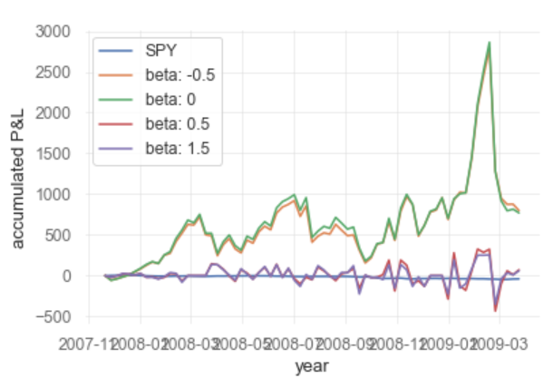
Beta effect during crisis

Slide 14
analysis
From the previous plots, we can see that the downturns in the market (blue line) impact the portfolio more the higher the target Beta. This is due to the increased correlation with the market returns. Oppositely, the lower target Beta portfolios are less impacted by these market downturns, with the negative target Beta portfolio experiencing the most upside of the portfolios during this period.

Slide 15
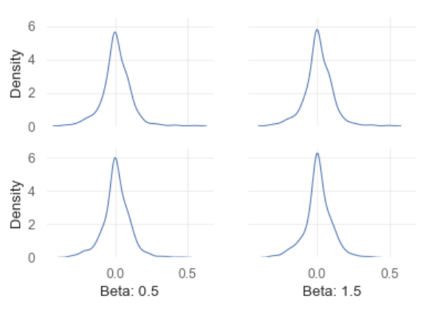
Beta effect during crisis

Slide 16
During crisis
 | S&P | 40 days | 80 days | 120 days
Accumulated Return (%) | -0.456081 | 3.310197e+00 | 2.743019e+00 | 2.629814e+00
sharpe ratio | -0.833068 | 1.234010 | 1.054494 | 1.602921
VaR | -0.041553 | -0.187979 | -0.183603 | -0.156335
Minimum | -0.098448 | -9.854829e-01 | -9.066256e-01 | -3.228125e-01
Maximum | 0.145198 | 6.410726e-01 | 5.938498e-01 | 4.958934e-01
Variance | 0.000598 | 1.434792e-02 | 1.349236e-02 | 1.022500e-02
Stdev | 0.024447 | 1.197828e-01 | 1.161566e-01 | 1.011188e-01
Skewness | 0.562078 | -1.197321e+00 | -1.193472e+00 | 2.713955e-01
Kurtosis | 6.065415 | 1.594653e+01 | 1.302347e+01 | 2.652787e+00
Beta = 0.5

Slide 17
analysis
During the crisis, lookback period has a fairly significant effect on the returns of the portfolio. Longer lookback periods, in this case, result in lower returns. This is because effects in the recent days or weeks are not captured due to the longer length of the lookback period. For this reason, the shorter periods are able to better capture these changes, which are downturns in this case. The portfolio is then able to “adapt” to this change much faster than the longer lookback period.

Slide 18
Post-crisis
 | S&P | Beta: -0.5 | Beta:0 | Beta: 1 | Beta: 1.5
P&L | 343.398946 | -703.348910 | -475.279017 | -90.752074 | 726.365704
sharpe ratio | 0.970596 | 0.372636 | 0.439839 | 0.491956 | 0.571700
VaR | -0.016631 | -0.101966 | -0.102417 | -0.103444 | -0.108583
Minimum | -0.109424 | -0.374391 | -0.376822 | -3.798572e-01 | -4.315268e-01
Maximum | 0.090603 | 0.821228 | 0.871687 | 9.117811e-01 | 1.015903e+00
Variance | 0.000110 | 0.003954 | 0.004010 | 4.107223e-03 | 4.553675e-03
Stdev | 0.010500 | 0.062879 | 0.063322 | 6.408762e-02 | 6.748092e-02
Skewness | -0.634462 | 0.785217 | 0.915281 | 1.059579e+00 | 1.679113e+00
Kurtosis | 13.180763 | 13.082770 | 15.119531 | 1.746393e+01 | 2.884019e+01
120 days of return
40 days of covariance

Slide 19
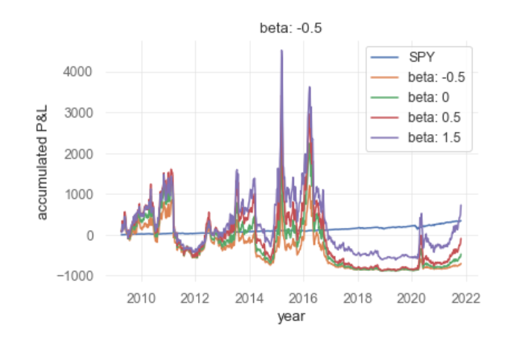
Beta effect After crisis

Slide 20
analysis
Post-Crisis, higher Beta portfolios are able to capture more of the positive returns from the market. Due to the market being mostly positive over this period, the higher target Beta portfolios perform better.

Slide 21
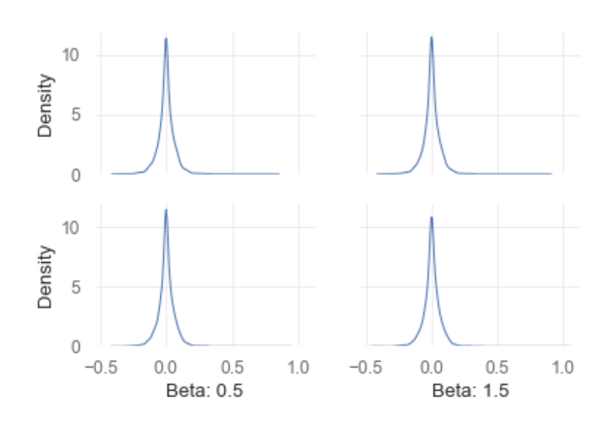
Beta effect aftercrisis

Slide 22
post crisis
 | S&P | 40 days | 80 days | 120 days
Accumulated Return(%) | 2.103421 | 4.083948 | 5.832306 | 5.748533
sharpe ratio | 0.970596 | 0.313177 | 0.440522 | 0.439835
VaR | -0.016631 | -0.102691 | -0.103745 | -0.102417
Minimum | -0.109424 | -0.495563 | -0.478381 | -0.484740
Maximum | 0.090603 | 1.428276 | 2.064953 | 1.923970
Variance | 0.000098 | 0.009121 | 0.011117 | 0.009999
Stdev | 0.009890 | 0.095504 | 0.105438 | 0.099995
Skewness | -0.764332 | 2.821557 | 4.954076 | 4.252434
Kurtosis | 19.328146 | 31.156666 | 77.227953 | 67.484487
Beta = 0.5

Slide 23
analysis
As opposed to during the crisis, a longer lookback period has a positive impact on returns. A longer period is able to take more data into account, which is beneficial in a more stable market. Thus, small daily changes have less of an impact, and the portfolio is able to capture market trends instead of weighting based on movements in the short-term.

Slide 24
global period
 | S&P | Beta: -0.5 | Beta: 0 | Beta: 0.5 | Beta: 1.5
P&L | 302.293511 | 83.995582 | 343.973965 | 739.572554 | 1303.492389
sharpe ratio | 0.569904 | 0.572352 | 0.625334 | 0.66563 | 0.707631
VaR | -0.020238 | -0.109358 | -0.108811 | -0.109011 | -0.113073
Minimum | -0.109424 | -3.74E-01 | -3.77E-01 | -3.80E-01 | -4.32E-01
Maximum | 0.145198 | 8.21E-01 | 8.72E-01 | 9.12E-01 | 1.02E+00
Variance | 0.000158 | 4.62E-03 | 4.59E-03 | 4.62E-03 | 4.99E-03
Stdev | 0.012576 | 6.80E-02 | 6.78E-02 | 6.80E-02 | 7.06E-02
Skewness | -0.05183 | 7.09E-01 | 7.56E-01 | 8.33E-01 | 1.27E+00
Kurtosis | 16.086044 | 1.09E+01 | 1.19E+01 | 1.34E+01 | 2.18E+01
120 days of return
40 days of covariance

Slide 25
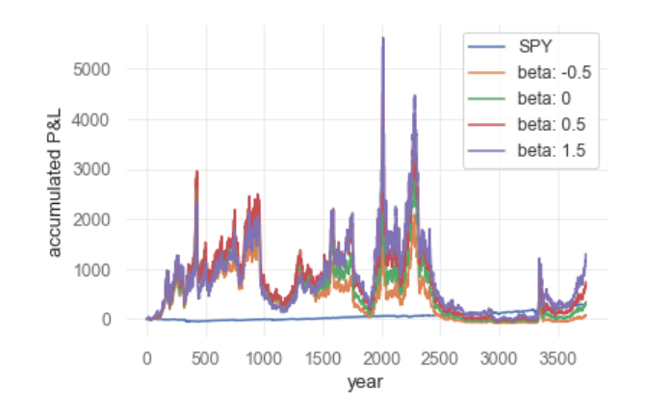
Beta effect in global period

Slide 26
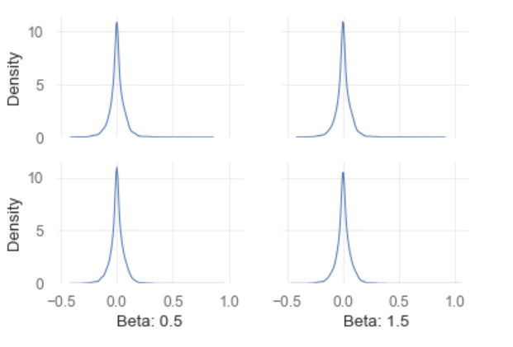
Beta effect in global period

Slide 27
Global period
 | S&P | 40 days | 80 days | 120 days
P&L | 1.688385 | 8.588598 | 9.477578 | 9.982517
sharpe ratio | 0.569904 | 0.515565 | 0.568639 | 0.62534
VaR | -0.020238 | -0.114038 | -0.113861 | -0.108811
Minimum | -0.109424 | -9.85E-01 | -9.07E-01 | -3.77E-01
Maximum | 0.145198 | 8.38E-01 | 8.32E-01 | 8.72E-01
Variance | 0.000158 | 5.00E-03 | 5.01E-03 | 4.59E-03
Stdev | 0.012576 | 7.07E-02 | 7.08E-02 | 6.78E-02
Skewness | -0.051835 | -5.30E-02 | -1.22E-01 | 7.56E-01
Kurtosis | 16.086004 | 2.09E+01 | 1.75E+01 | 1.19E+01
Beta = 0.5

Slide 28
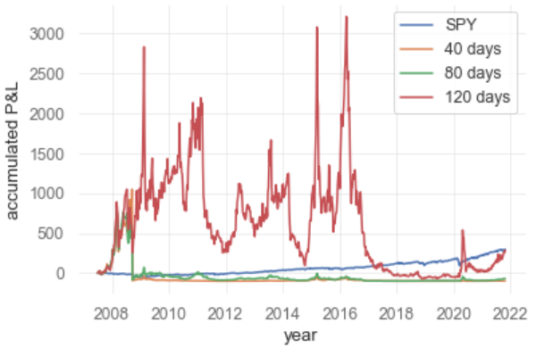
Term structure effect in global period

Slide 29
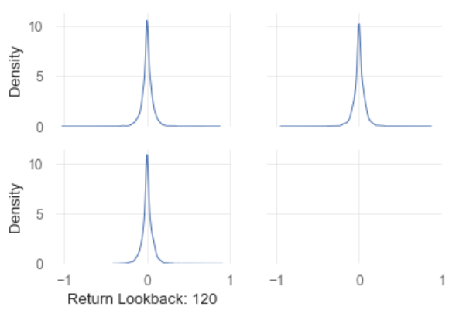
Term structure effect in global period

Slide 30
Data Summary
During Crisis:
Target Beta and Returns are inversely correlated
Slightly more Variance of Returns
Longer lookback period results in worse returns
Post Crisis:
Target Beta and Returns are directly correlated
Less Variance of Returns
Longer lookback period results in better returns
Both:
Variance decreases as Target Beta increases
Lookback period doesn’t have much significant effect on Variance

Slide 31
Conclusion
Target Beta has a different effect for the crisis period compared to the pre- and post-Crisis periods. During the crisis, a higher Beta results in decreased returns. This is due to the negative market performance, so the returns of the portfolio are decreased when they are highly correlated with the market. For the post-crisis and pre-crisis periods, the opposite is true, as the market is positive (or almost even) over this period. Thus, the returns are higher with an increased target Beta.
In all time periods, volatility is directly correlated to Beta, while skewness and Beta are inversely related.
Similarly, the relationship between the length of the lookback period and the returns of the portfolio is different between the periods. During the crisis, a longer lookback period results in lower returns. This could be a result of taking into account information from a pre-crisis market, which is no longer relevant during the crisis. Conversely, a longer lookback period results in a better return post-crisis. This is the case under “normal” conditions. For the pre-crisis period, lookback period does not have as significant an impact as the other periods.

